Slide 1

INTERNET OF THINGS
IoT Network Architecture and Design
Dr. Nagegowda K S
Department of Computer Science & Engineering

Slide 2

INTERNET OF THINGS
Introduction to IoT
Chapter2: IoT Network Architecture and Design
Dr. Nagegowda K S
Department of Computer Science & Engineering

Slide 3
INTERNET OF THINGS
Agenda
Drivers Behind New Network Arhitectures
Comparing IoT Architectures
A Simplified IoT Architecture
The Core IoT Functional Stack
IoT Data Management and Compute Stack

Slide 4
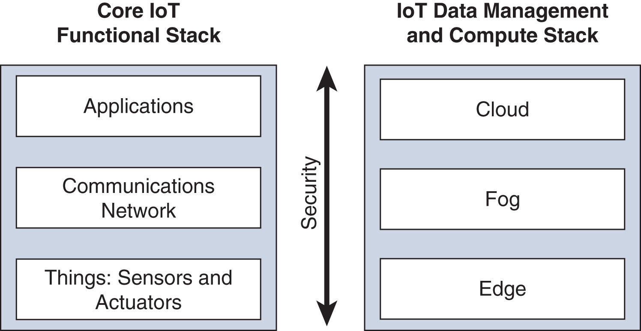
INTERNET OF THINGS
A Simplified IoT Architecture

Slide 5
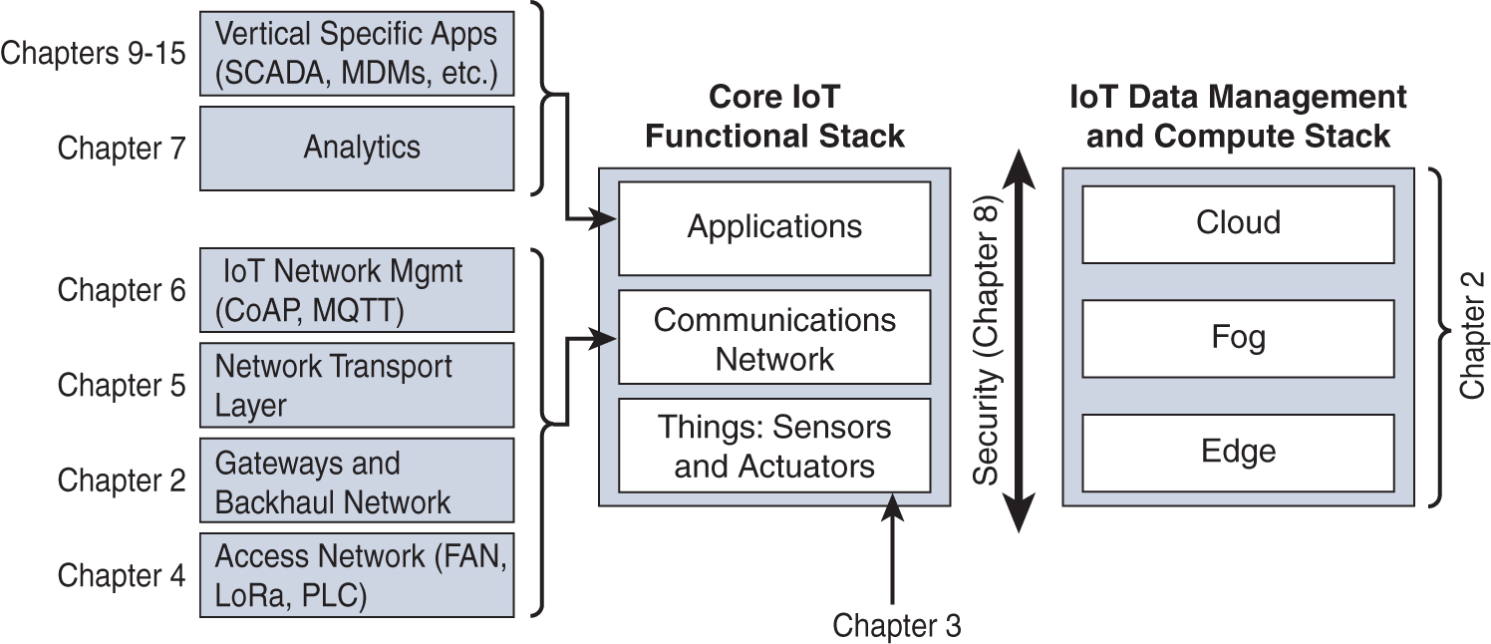
Expanded View of the Simplified IoT Architecture
INTERNET OF THINGS

Slide 6
INTERNET OF THINGS
The Core IoT Functional Stack
Things layer
Communication Network layer
Access network sublayer
Gateways and backhaul network sublayer
Network transport sublayer
IoT network management sublayer
Application and analytics layer

Slide 7
INTERNET OF THINGS
Layer 1: Things: Sensors and Actuators Layer
Battery-powered or power-connected
Mobile or static
Low or high reporting frequency
Simple or rich data
Report range:
Object density per cell

Slide 8
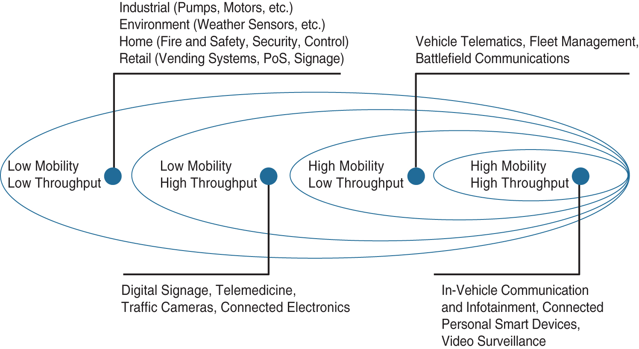
INTERNET OF THINGS
Layer 1: Things: Sensors and Actuators Layer

Slide 9
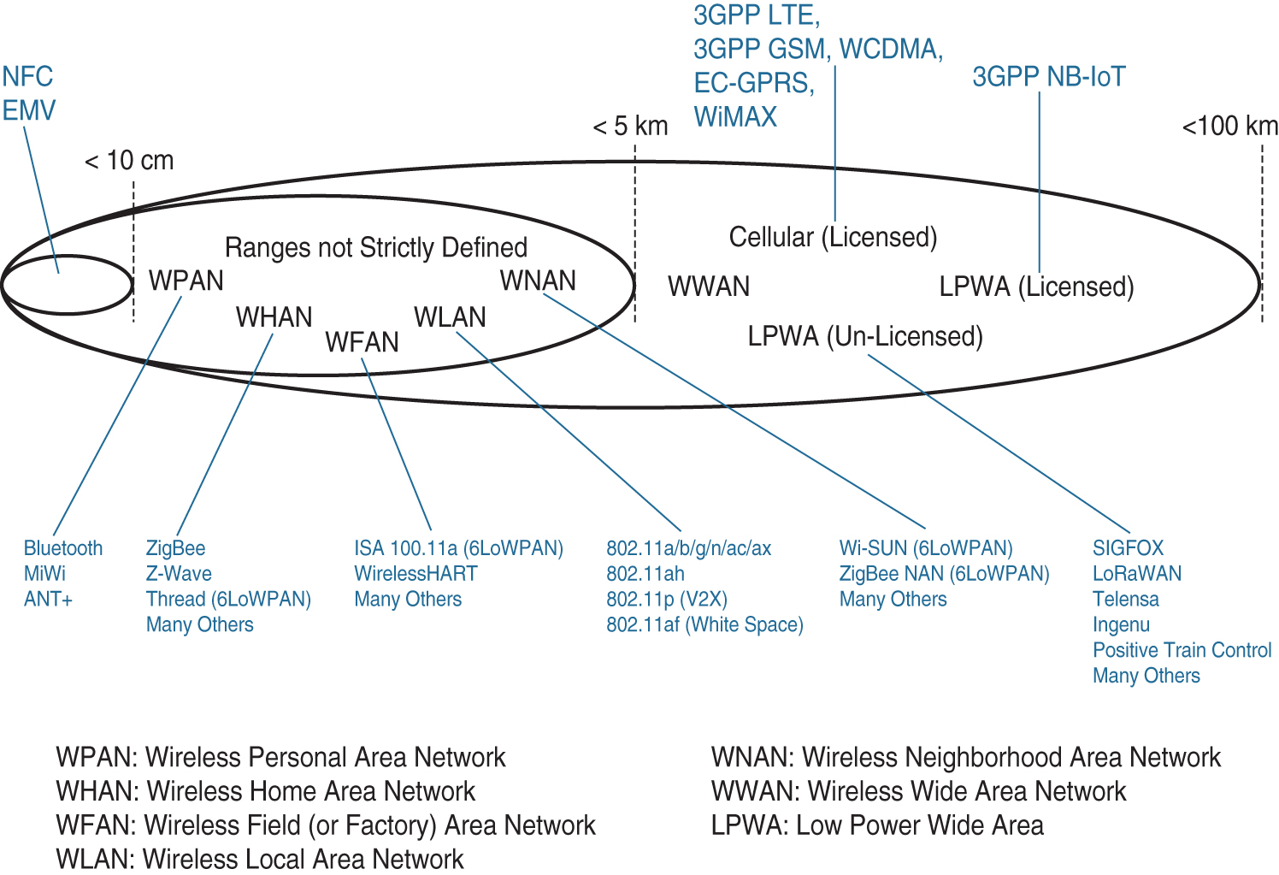
INTERNET OF THINGS
Access Network Sublayer

Slide 10
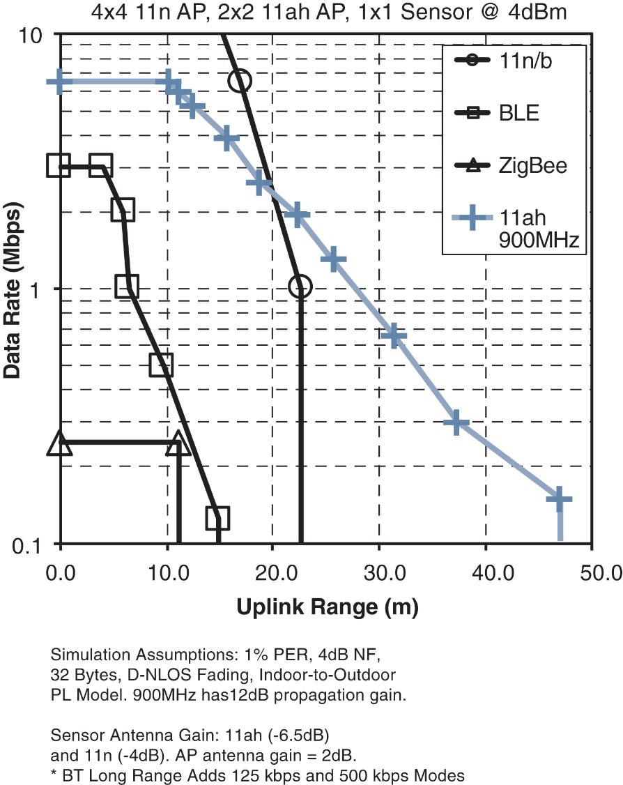
INTERNET OF THINGS
Access Network Sublayer
Figure: Range Versus Throughput for Four WHAN to WLAN Technologies

Slide 11
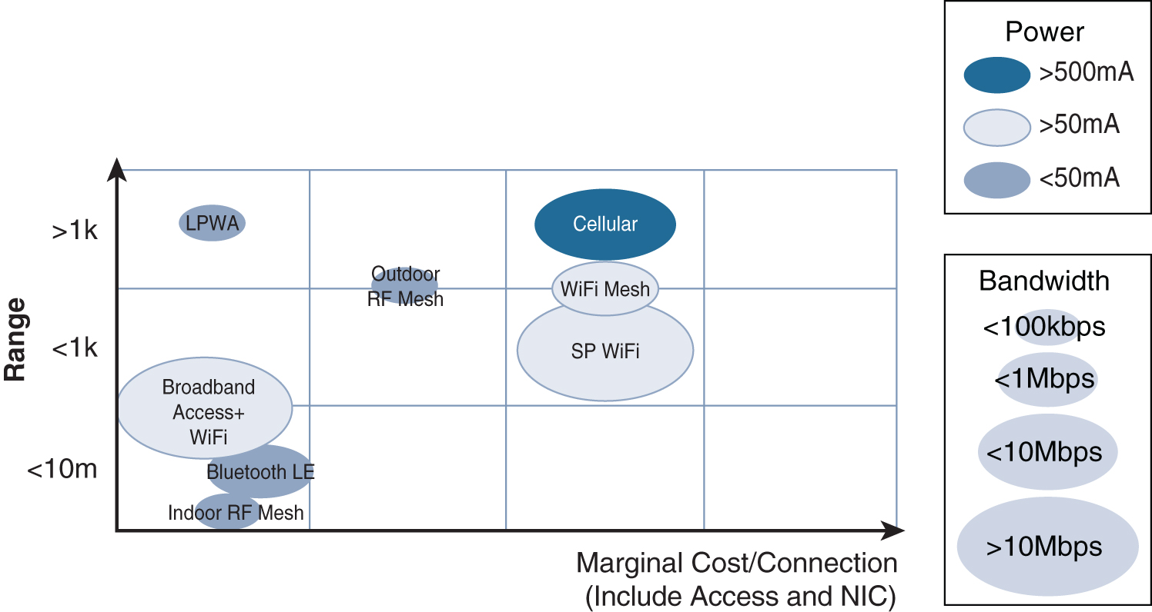
INTERNET OF THINGS
Access Network Sublayer
Figure: Comparison Between Common Last-Mile Technologies in Terms of Range Versus Cost, Power, and Bandwidth

Slide 12
INTERNET OF THINGS
Layer 3: Applications and Analytics Layer
Analytics Versus Control Applications
Data Versus Network Analytics
Data Analytics Versus Business Benefits
Smart Services

Slide 13
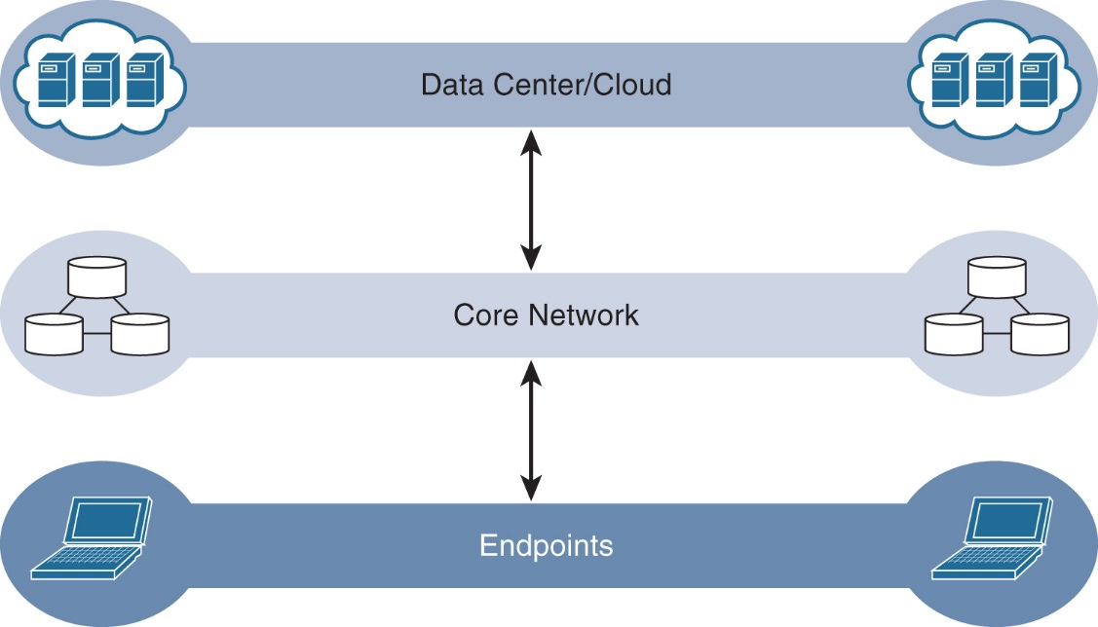
INTERNET OF THINGS
IoT Data Management and Compute Stack-Cloud Computing
Figure : The Traditional IT Cloud Computing Model

Slide 14
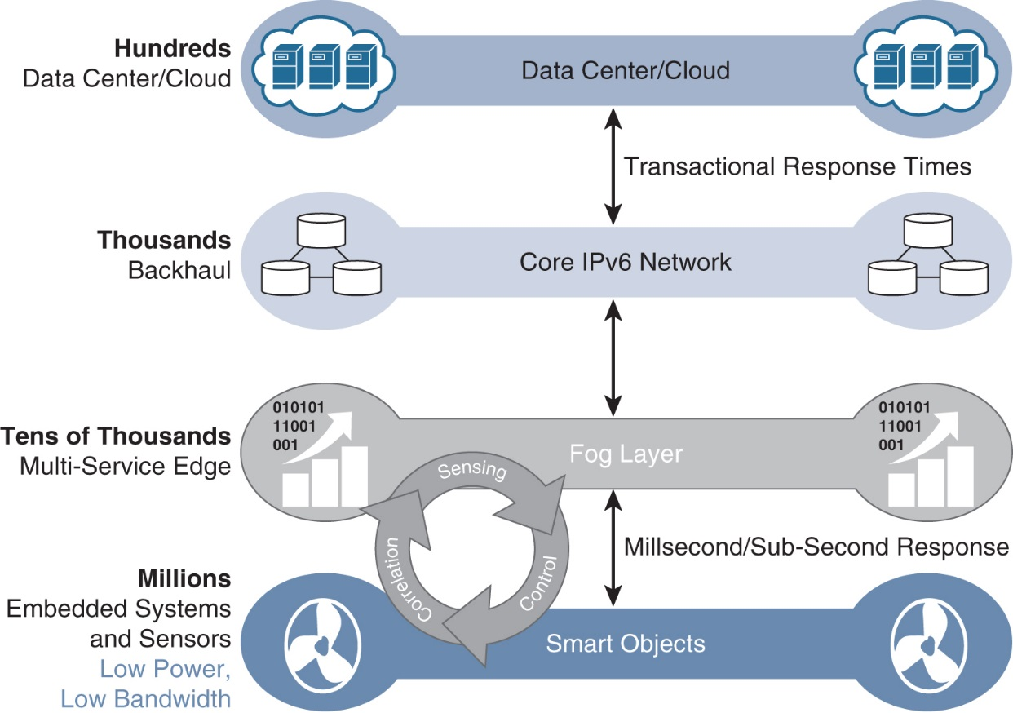
INTERNET OF THINGS
IoT Data Management and Compute Stack-Fog Computing
Figure : The IoT Data Management and Compute Stack with Fog Computing

Slide 15
IoT Data Management and Compute Stack-Fog Computing
INTERNET OF THINGS
The defining characteristic of fog computing are as follows:
Contextual location awareness and low latency
Geographic distribution
Deployment near IoT endpoints
Wireless communication between the fog and the IoT endpoint
Use for real-time interactions

Slide 16
IoT Data Management and Compute Stack-Edge Computing
INTERNET OF THINGS
Edge computing is also sometimes called “mist” computing. If clouds exist in the sky, and fog sits near the ground, then mist is what actually sits on the ground. Thus, the concept of mist is to extend fog to the furthest point possible, right into the IoT endpoint device itself.

Slide 17
THANK YOU
Dr. Nagegowda K S
Department of Computer Science & Engineering
nagegowda@pes.edu

